Slide 1
Code Quality
Is f***ing important

Slide 2
Code Communicate intend and goals

Slide 3
What is code quality? Code quality is a loose approximation of how long-term useful and long-term maintainable the code is

Slide 4
Code quality can translate into how useful and maintainable your code is: high-quality code can be re-used and re-developed; low-quality code doesn’t last.

Slide 5

Why is code quality so important? High quality code also much easier to understand, maintain and extend, leading to a much lower development effort.

Slide 6
What is good code?

Slide 7
Software functional quality Software structural quality

Slide 8
The Code Does What It Should
High quality code serves its intended purpose.
This means that high-quality code doesn't have bugs, performance issues, security holes, or other things that render it unfit for purpose.

Slide 9
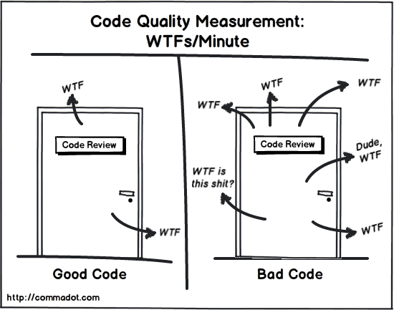
Code Quality: Definition by Negation
When you have code of poor quality, it confuses people and defies comprehension.
Code of good quality -- people should understand it quickly and easily.

Slide 10
Code quality is not just about code
The architecture
The design pattern

Slide 11
Ten tips for better code

Slide 12
#1
You
are responsible for the quality of your code
Part of being a professional is being honest about how long it takes to do something well, and not accepting the option to do it wrong

Slide 13
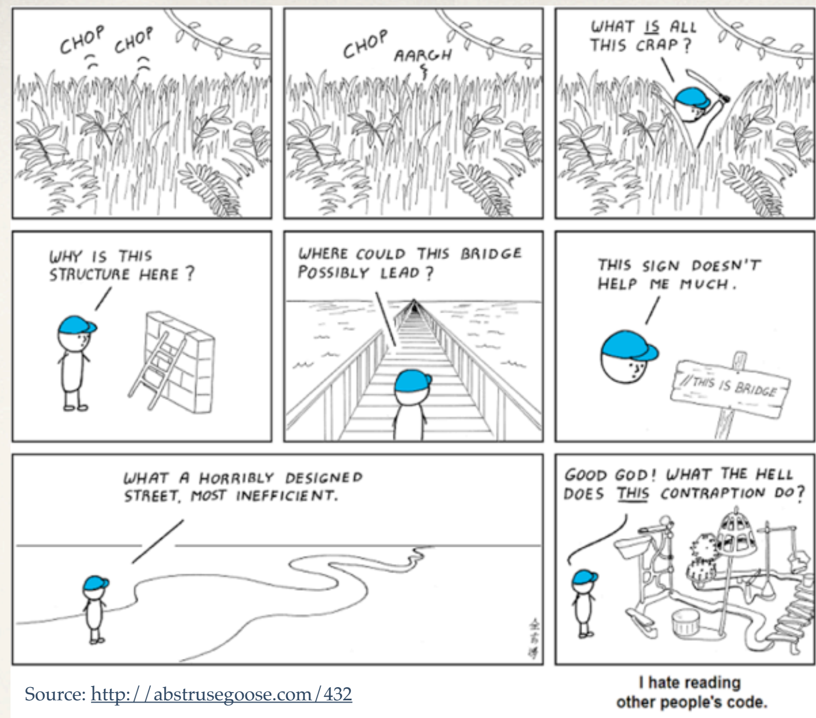
It’s not just other people’s code, it’s your own code, 6 months later
But it doesn’t have to be this way

Slide 14
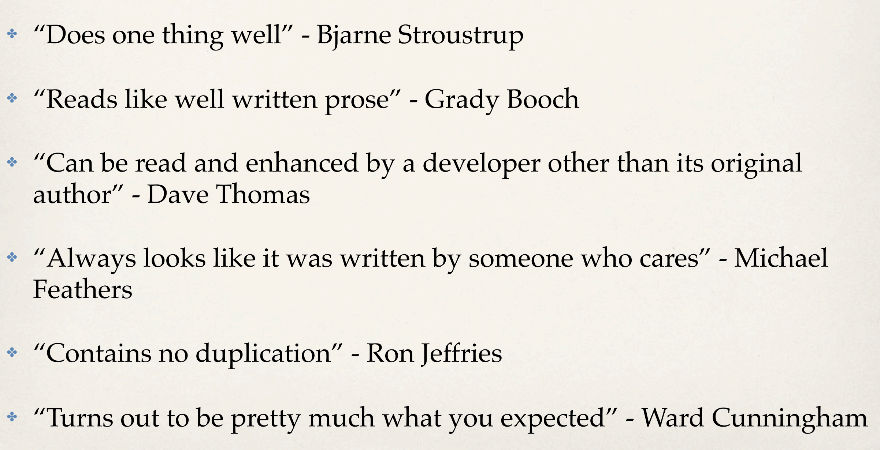

Slide 15
That sounds nice, but I have a deadline I don't have time for clean code!

Slide 16
Do you want your emergency room doctor to rush your surgery?
Software Engineering is Craftsmanship

Slide 17
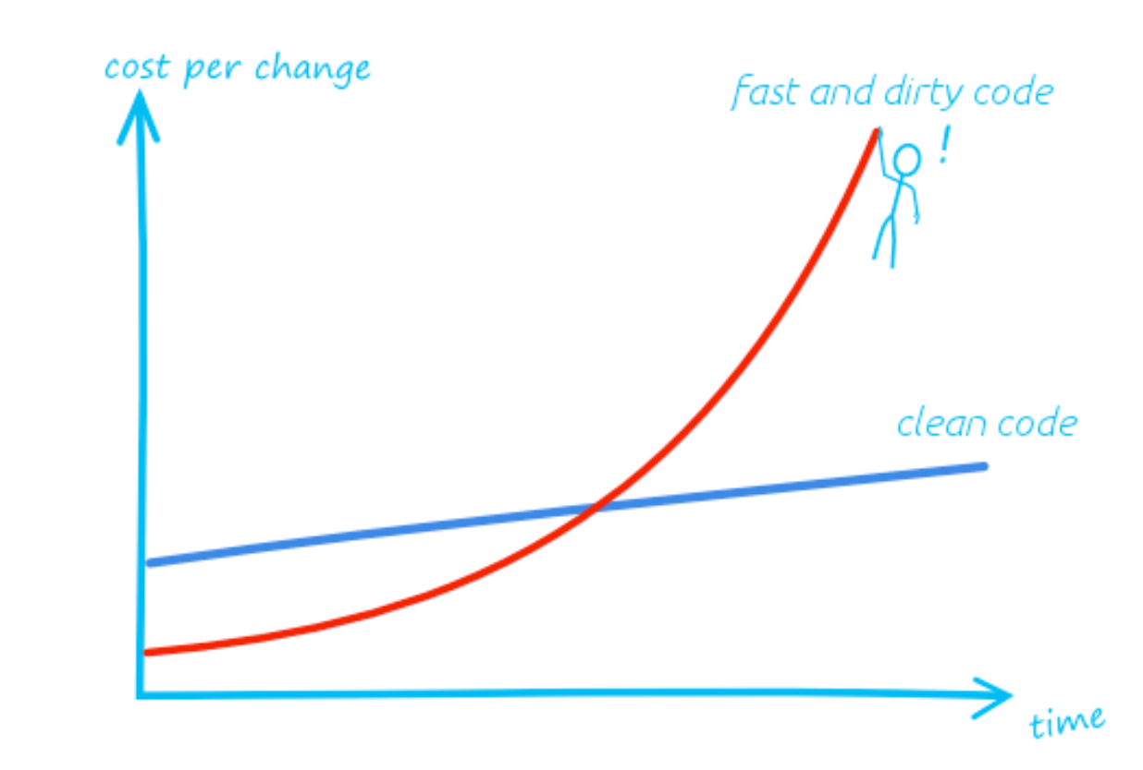

Slide 18
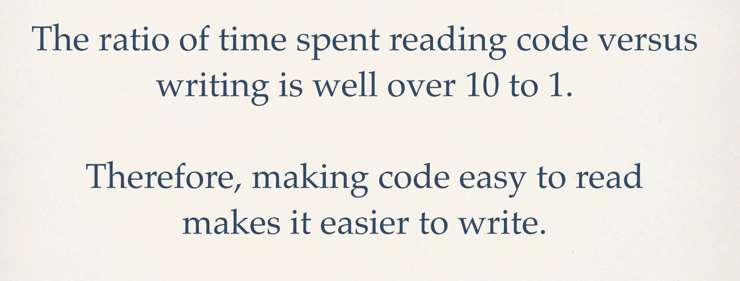
We like to think we spend our time power typing, but we actually spend most of our time staring into the abyss.

Slide 19
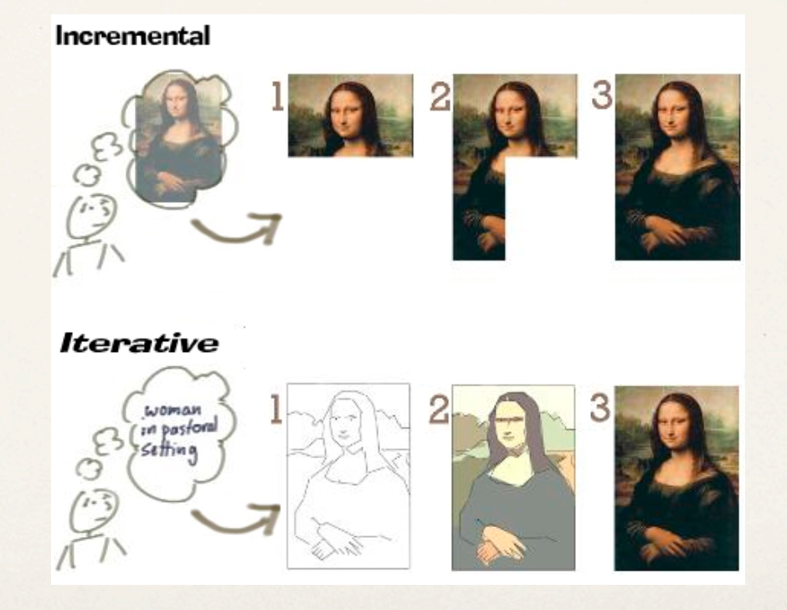
#2
Work in short cycles: incremental and iterative

Slide 20
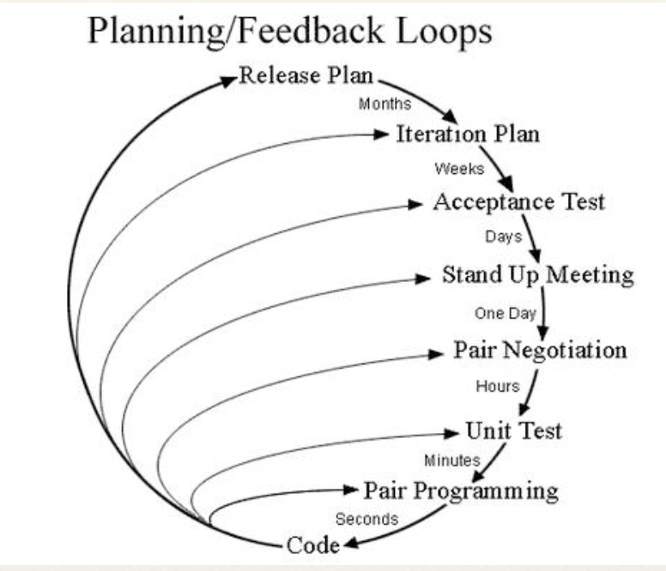
Develop systems in small portions at a time (incremental), through repeated cycles (iterative),and take advantage of what was earned in each cycle (for both features and implementation).
This workflow style complements the clean code style. Work on one thing, do it well, then move on to the next thing.
Notes:
案例？wyx

Slide 21
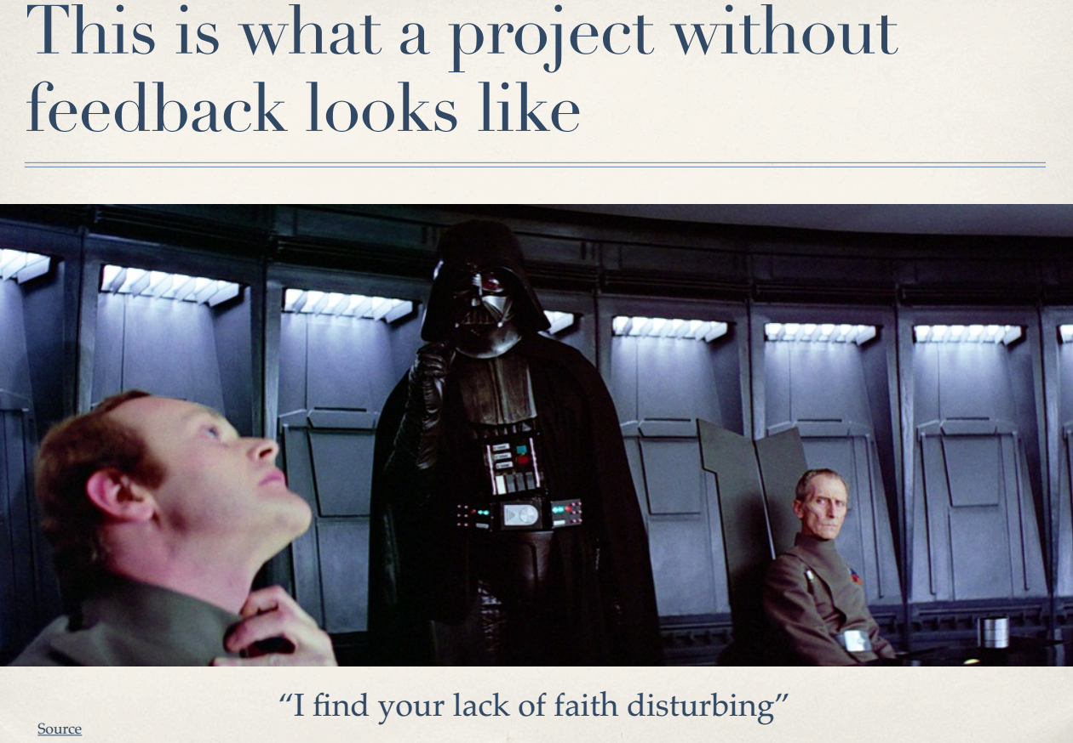

Slide 22
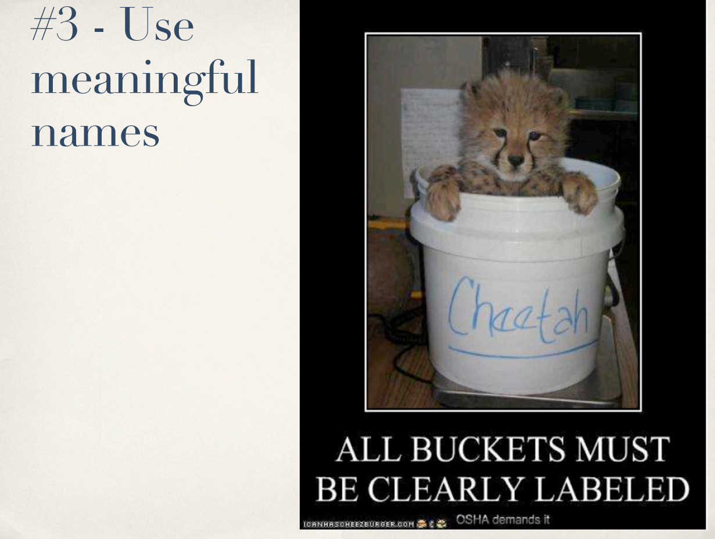

Slide 23
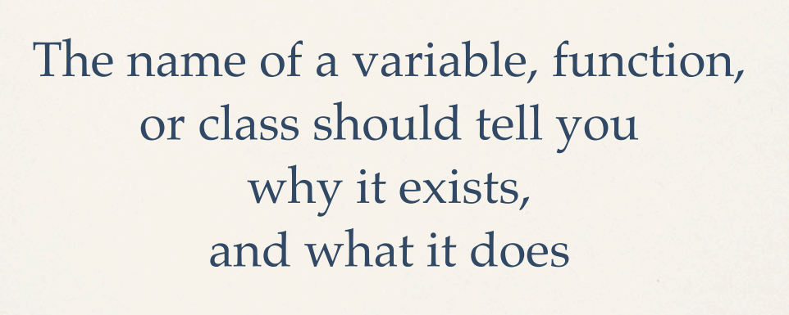

Slide 24
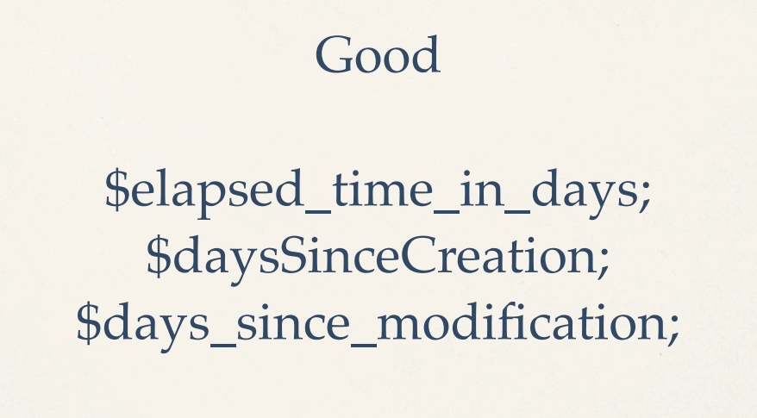
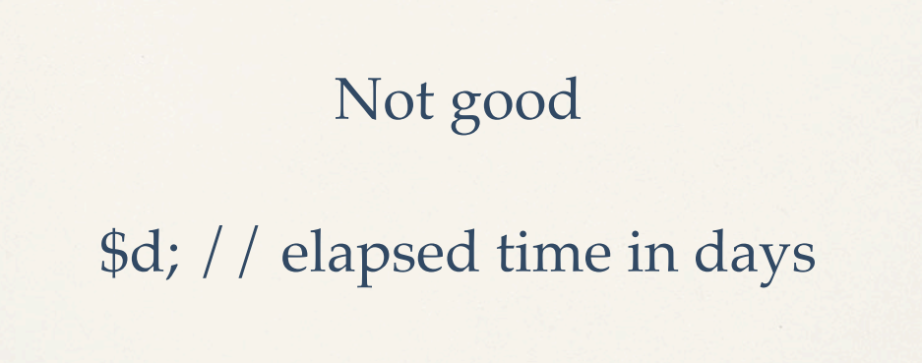
Notes:
谢飞，

Slide 25
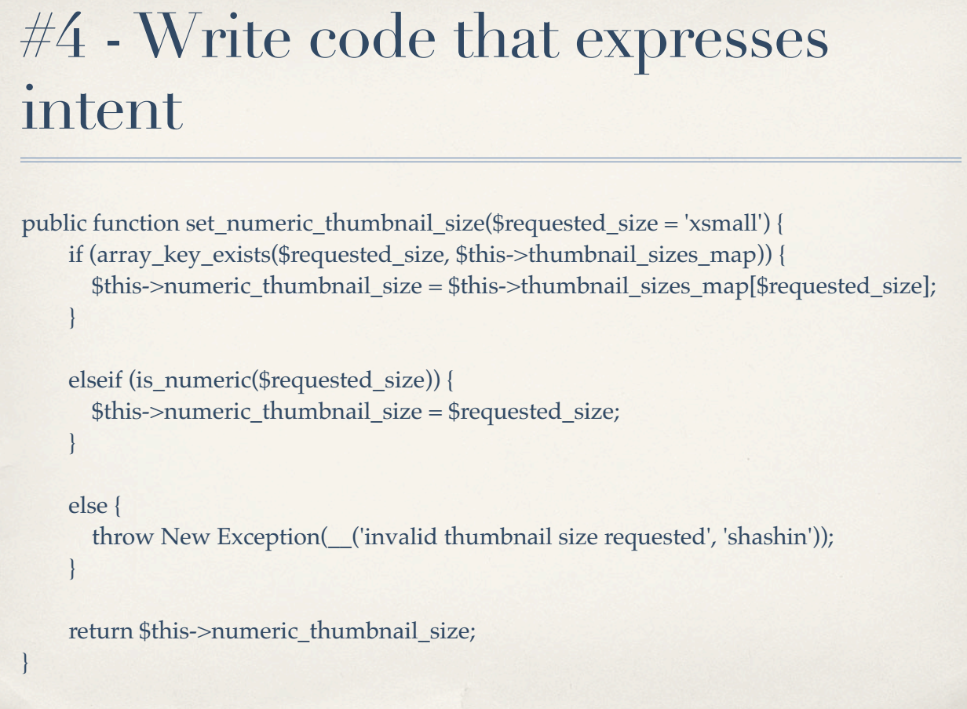

Slide 26
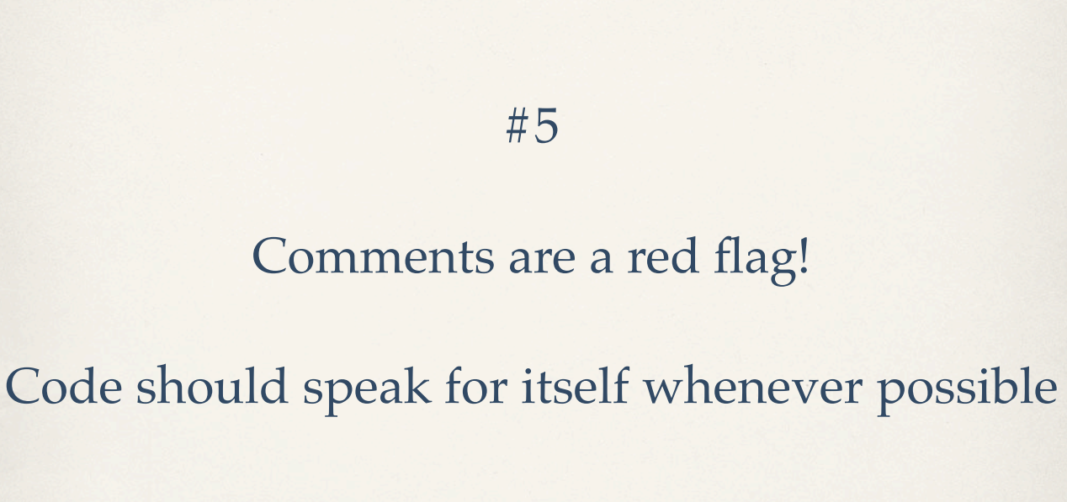
Lies
The point is to stop and think before you write a comment, and ask yourself if instead you can make the code more expressive
The point is to stop and think before you write a comment, and ask yourself if instead you can make the code more expressive
//The Persons First Name
public string FirstName { get; set;}
Notes:
例子，稀烂，没有意义的注释，谢飞

Slide 27

#6
Leave the code better than you found it

Slide 28



Slide 29
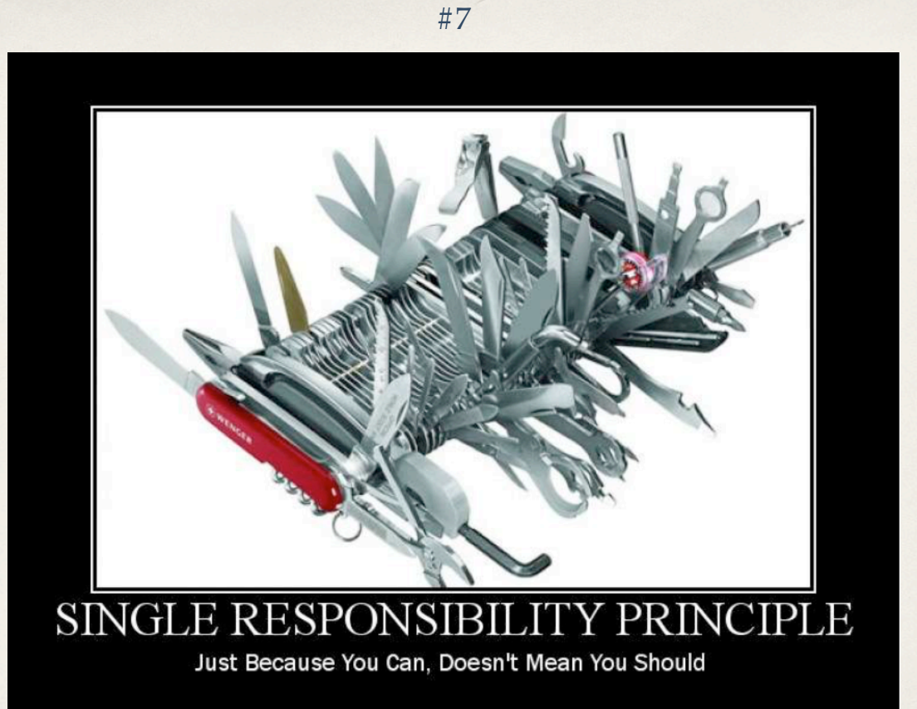
Notes:
wqq

Slide 30
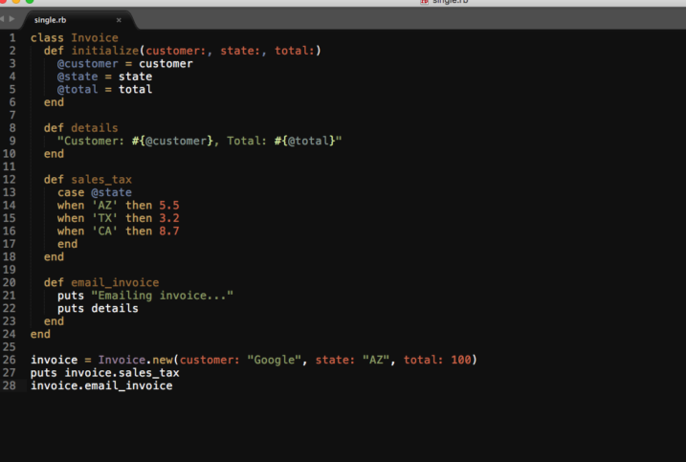

Slide 31
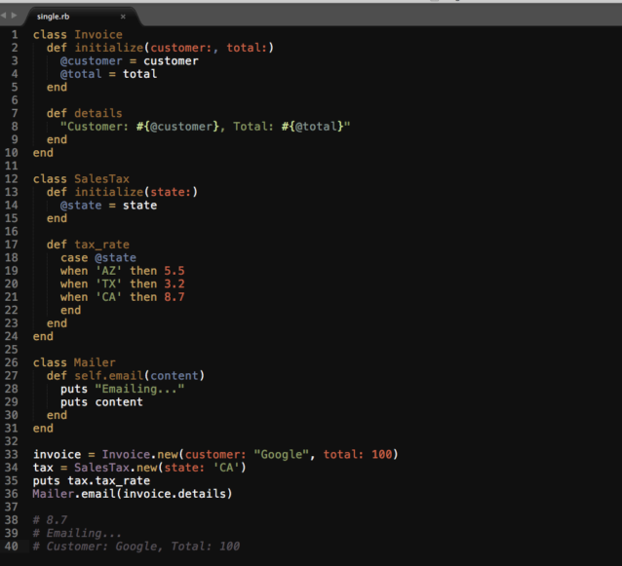

Slide 32
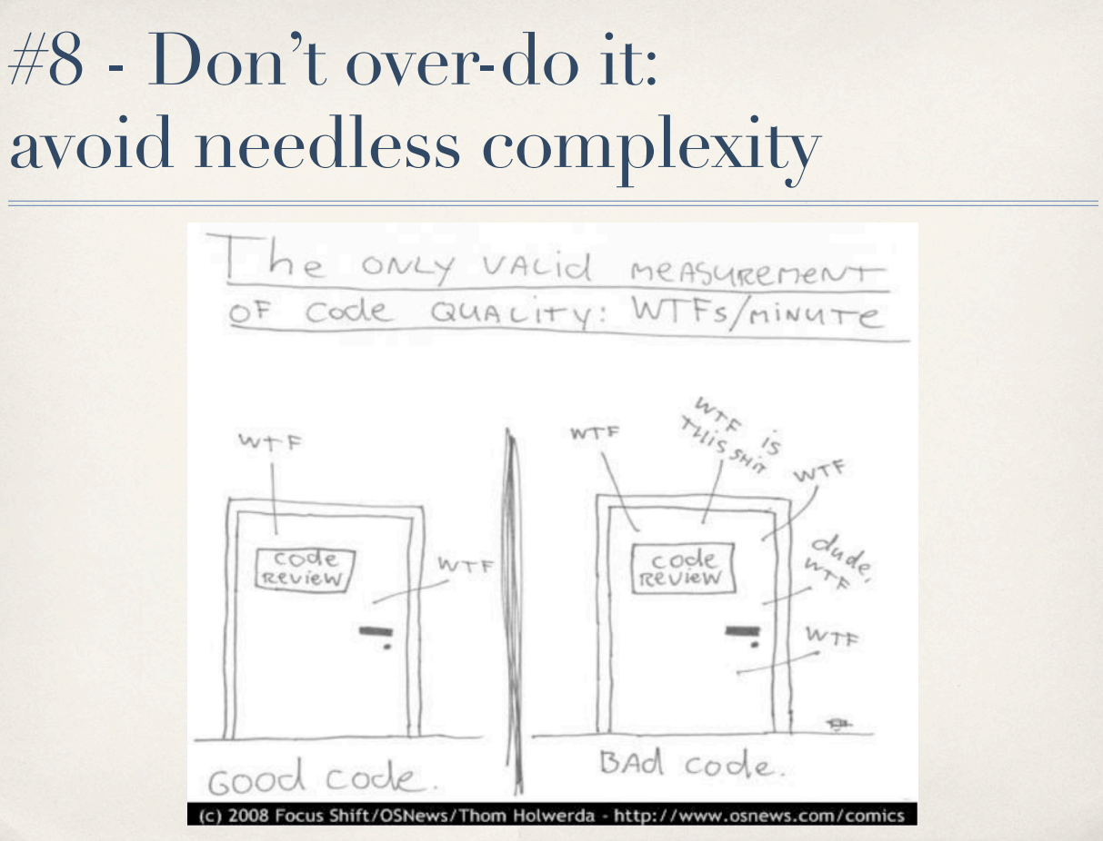
Notes:
wyx

Slide 33
#9 Be constant！
Notes:
谢飞

Slide 34
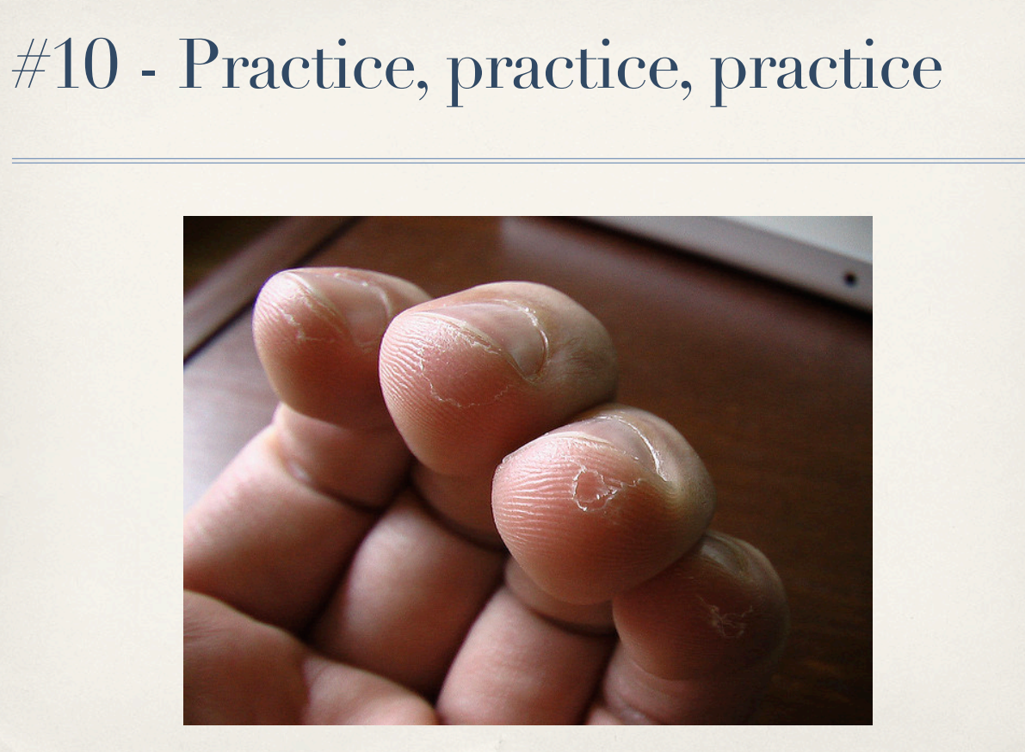

Slide 35
One more
Don’t trust you data
public class Program
{
public static void Main(string[] args )
{
var me=new Person("zheng");
//var me=new Person("");
Console.WriteLine("Hello "+me.LastName);
}
}
public class Person
{
public string LastName{get;set;}
public Person(string lastName)
{
LastName= lastName.First().ToString().ToUpper() + lastName.Substring(1);
}
}

